Slide 1

Credit Card
Analysis
Presented by:
Manal Bayoumi
Rocio Cantu
Scott Malone

Slide 2
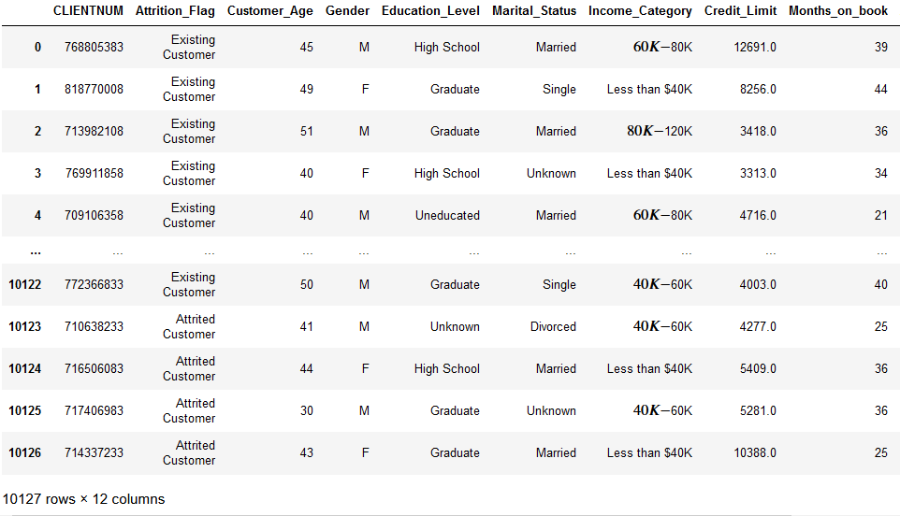
About the Dataset
The dataset details the relationship between credit card customers and their debt.

Slide 3
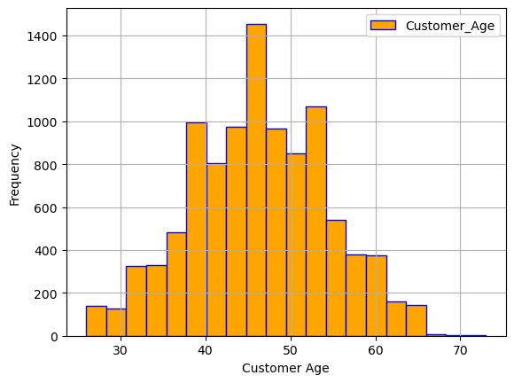
Customer age

Slide 4
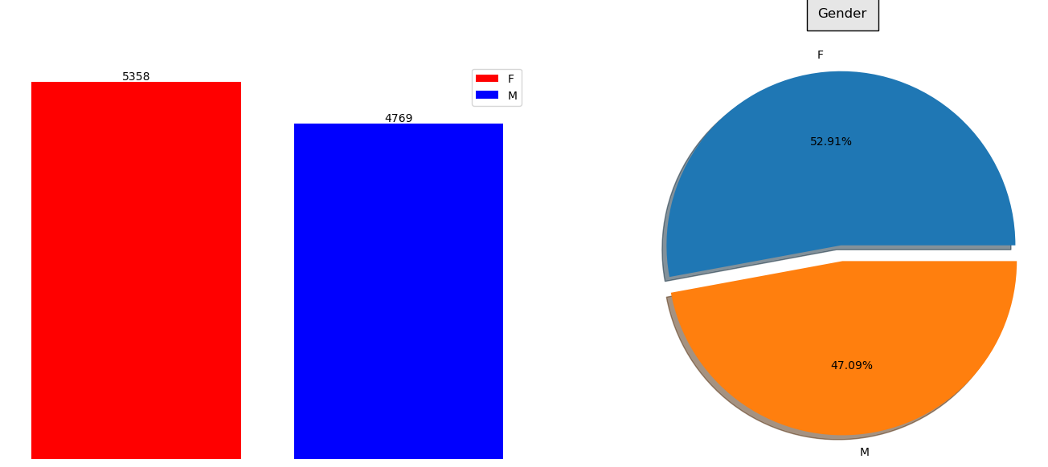
Customer gender

Slide 5
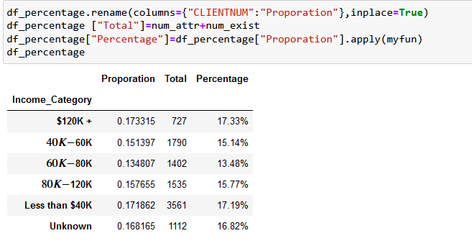
How does income affect credit card debt?
Clients with higher incomes acquire more credit card debt.
Notes:
Customers with income higher than $120K default more on their credit cards by 17.33% than those with less than $40K; they default by about 17.19%,

Slide 6
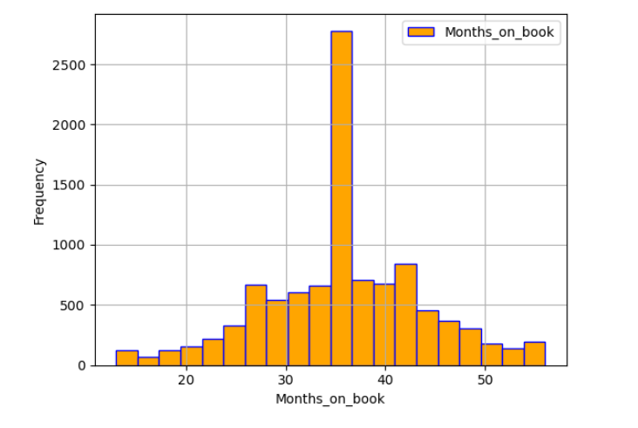
What causes most credit card debt?
Mostly, customers only pay the minimum payment on the credit card statement.

Slide 7
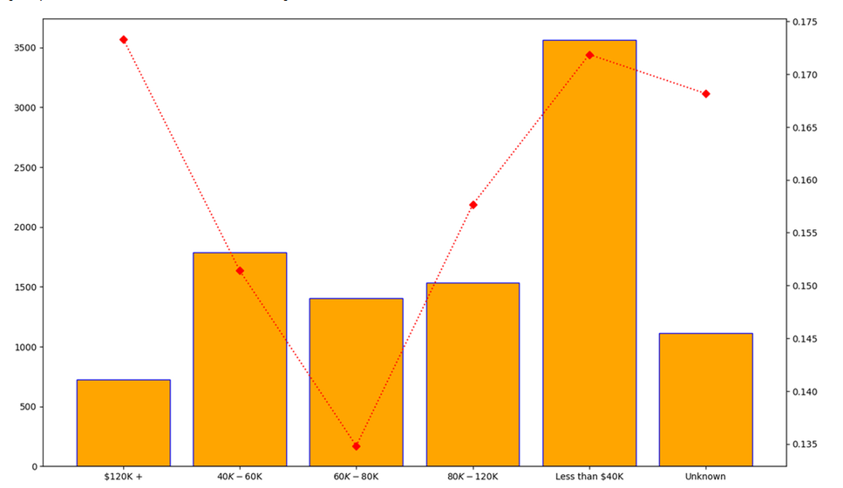
Is credit card debt worse for those with income greater than $100,000 or with households of lower income?
Debt is greater for those with higher incomes.

Slide 8
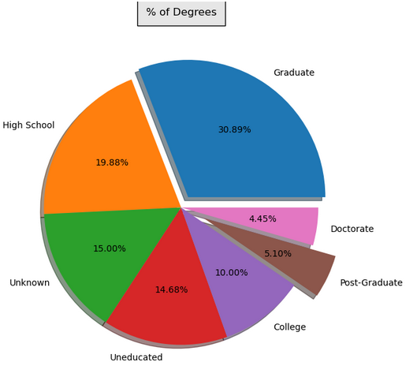
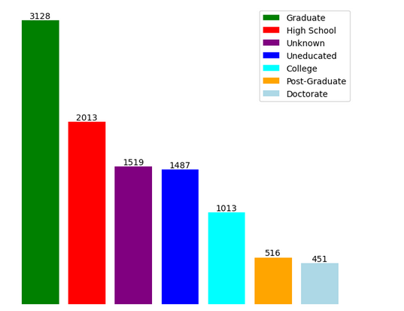
Is there a correlation between income, education, and credit card debt?
Notes:
Those with higher achieving degrees default more on their credit card than those with lower ones.

Slide 9
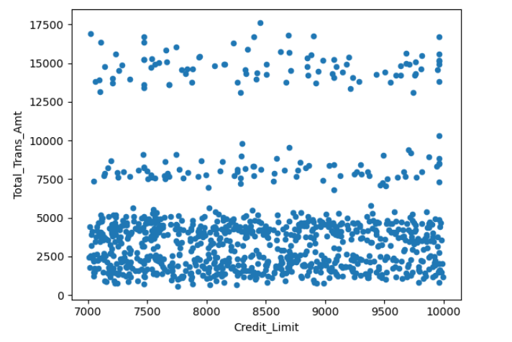
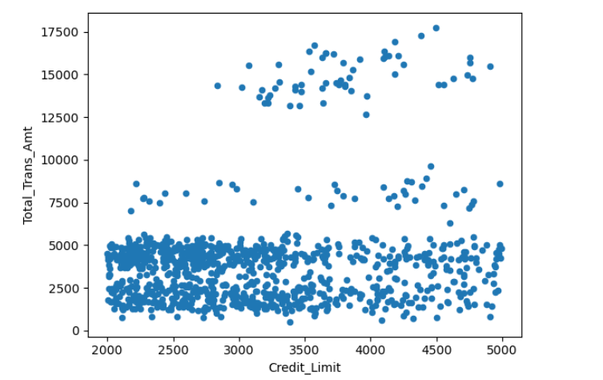
TTest
If the credit limit is decreased, the total transitions significantly decrease. Therefore, to decrease the customers’ credit card debt, their credit line must also be decreased.

Slide 10
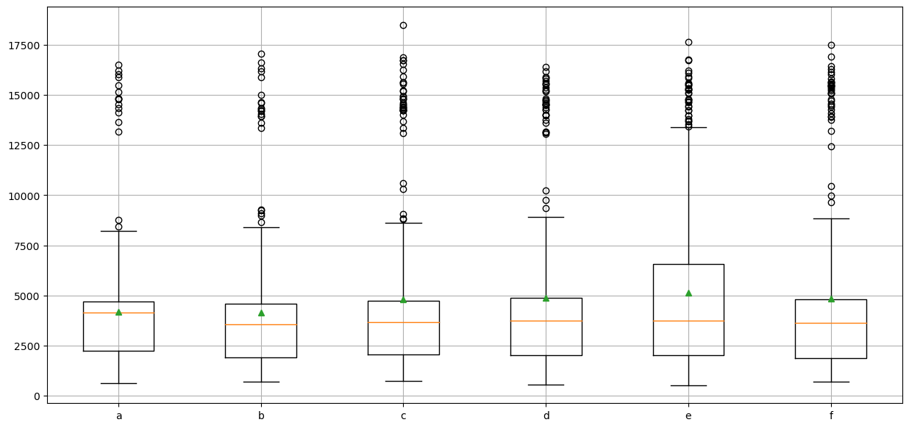
Anova
Extension of the TTest.
The distribution is significantly different because the mean value is different in these groups and outlier group (Q3+1.5IQR) is different.

Slide 11
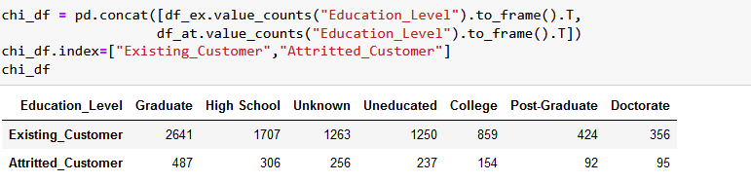
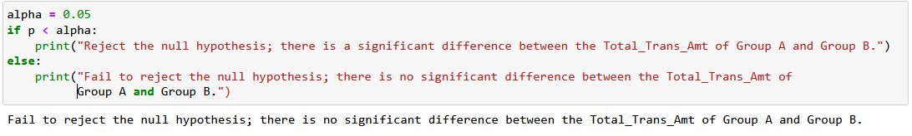
Chi square Test

Slide 12


